Slide 1

Genitive inversion in Norwegian
Lars G Johnsen
National Library of Norway
Lars.johnsen@nb.no
Qualico 2021 – Tokyo, Japan

Slide 2
Genitive inversion
Hans arm er sterk
His arm is strong
Armen hans er sterk
Arm#def his is strong
(the arm of his is strong)
Notes:
Problem is that both are judged equally good. Among the Scandinavian languages, the postnominal (def + poss) is unique.

Slide 3
National Library of Norway
600 000 books
3 million newspapers
80 000 periodicals
Feature sets (frequency lists, concordances, collocations etc.) available over an API.
Website: https://ww.nb.no
API: https://github.com/Yoonsen/Modules
N-gramreader: https://www.nb.no/sprakbanken/ngram

Slide 4
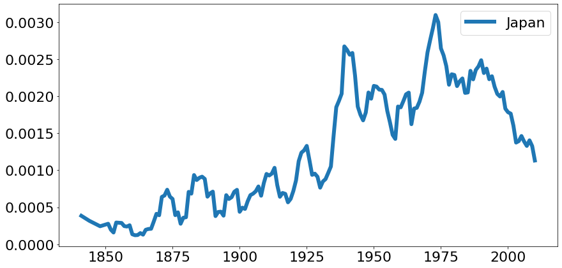
N-grams database
Set of frequencies, bigrams and trigrams with frequency information for each year from 1810 to 2010.

Slide 5
Bigrams and interpretation
A bigram does not point to a syntactic relation
Extracting <noun, poss> is it a possessive construction?
Testing using NDT – Norwegian Dependency Treebank
As well as extracting concordances (concordances may be parsed)
NDT:
https://www.nb.no/sprakbanken/ressurskatalog/oai-nb-no-sbr-10/
Notes:
Testing using the Norwegian Dependency Treebank
These may also be parsed afterwards.

Slide 6
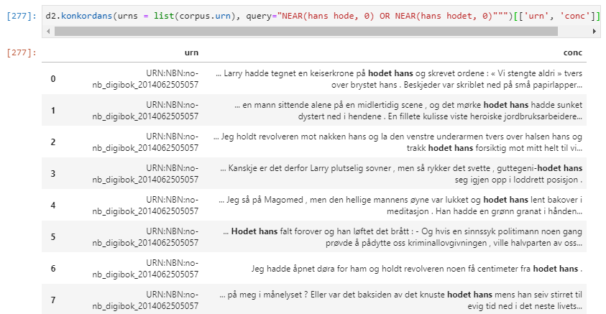
concordance

Slide 7
The basic observation
Notes:
What happens to the construction.
A: it starts out prenominal

Slide 8
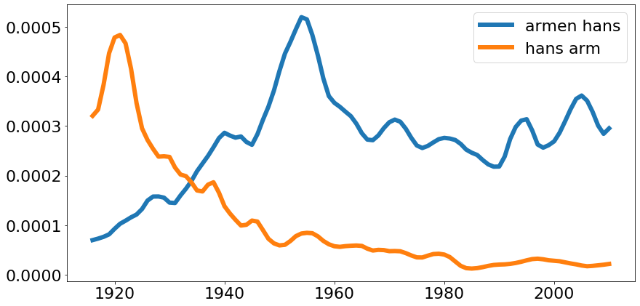
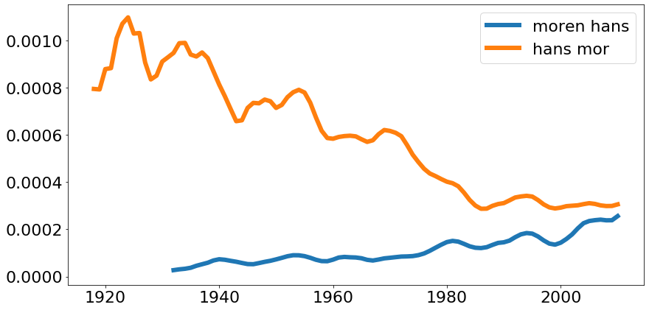
Body part
arm#def his
his arm
Family
mother#def his
his mother
Notes:
Example – how does things fall in between?
Random selection.
Support the claim that postnominal is increasing, prenominal is decreasing.
Why did it start to rise in the first place?
Some cases in 1900th century – «friend my» venen min – used vocatively.

Slide 9
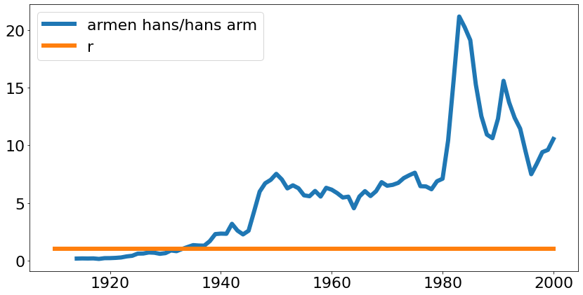
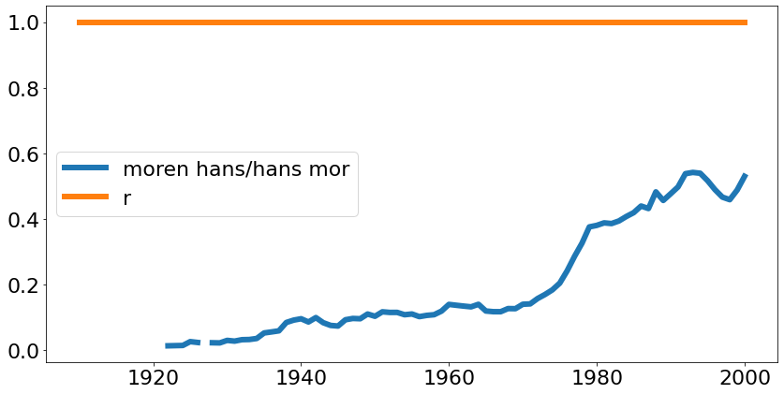
Notes:
Example – how does things fall in between?
Random selection.
Support the claim that postnominal is increasing, prenominal is decreasing.
Why did it start to rise in the first place?
Some cases in 1900th century – «friend my» venen min – used vocatively.

Slide 10
Goal
Look at the historical development
What is the general tendency?
What factors influence the choice?
Hypothesis -

Slide 11
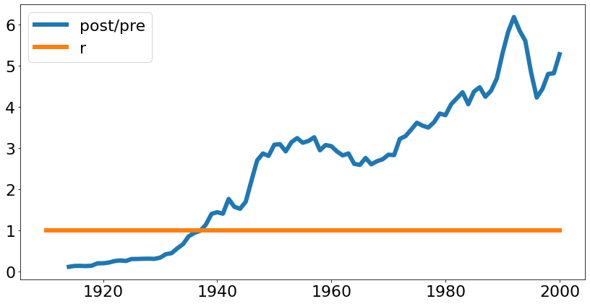
Body parts – aggregated
Notes:
From head to toe – singular (mostly)

Slide 12
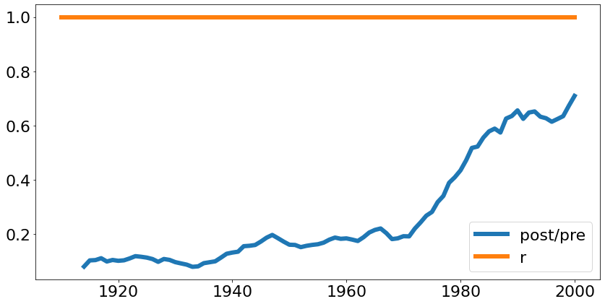
Family aggregated
Notes:
Core family

Slide 13
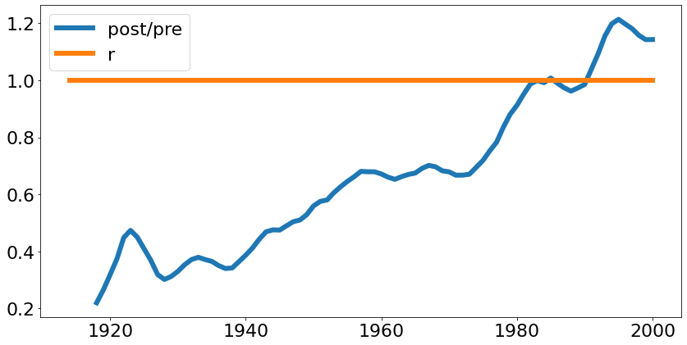
Some selected objects

Slide 14
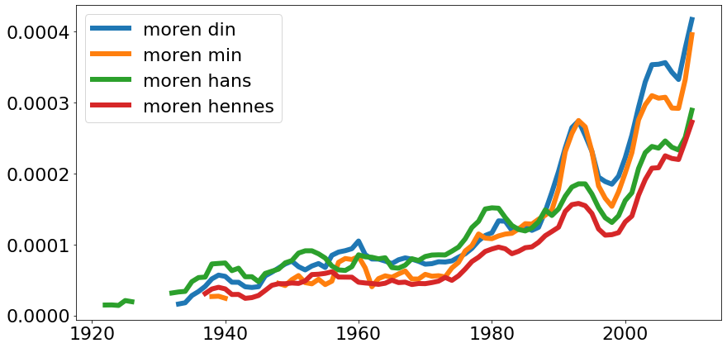
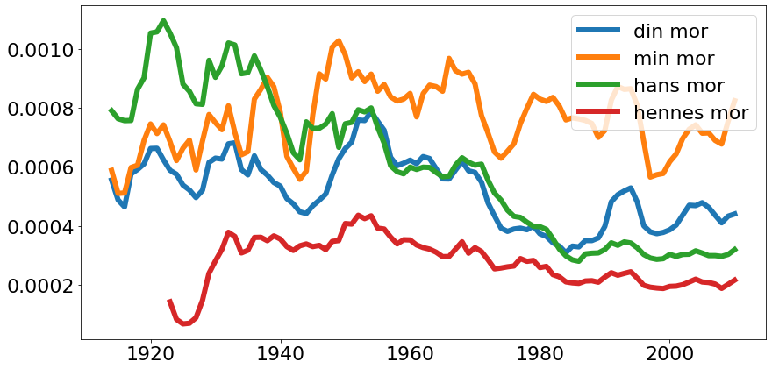
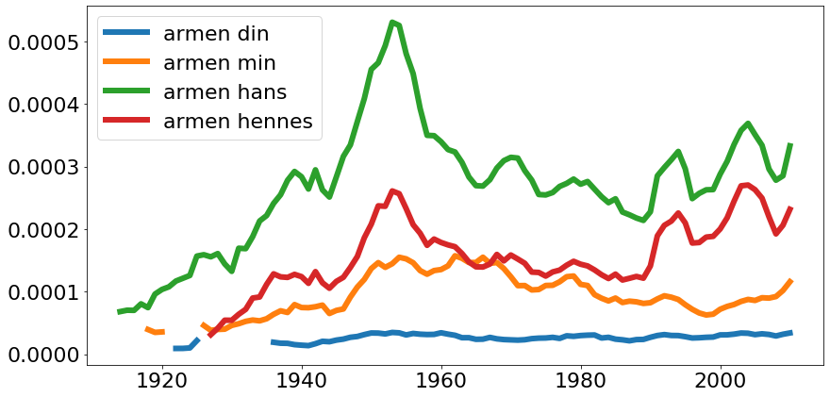
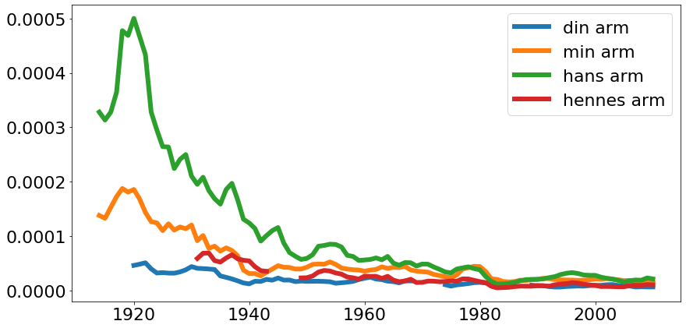
Influence of possessor pronoun
Yours = din
Mine = min
His = hans
Her = hennes
Notes:
If we align on

Slide 15
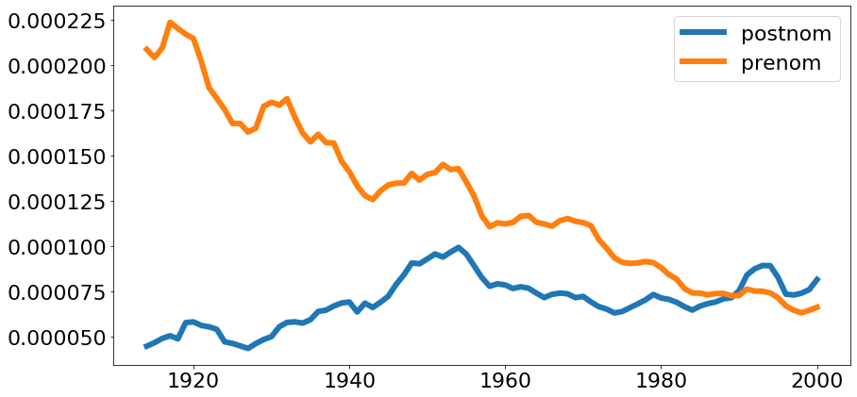
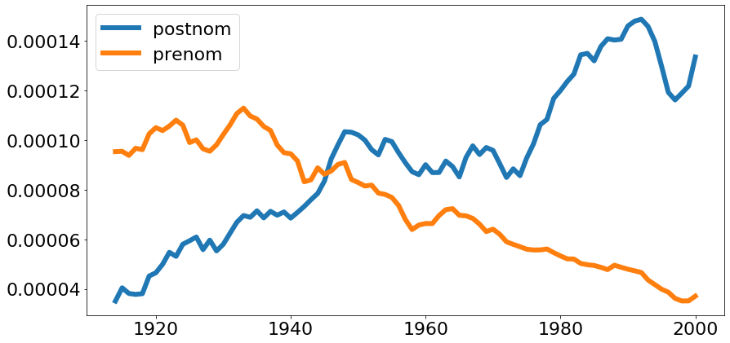
Trendlines for a random selection of nouns
Notes:
Taken from a sample of nouns among the 2500 most frequent words. The first is just a randmom sample.

Slide 16
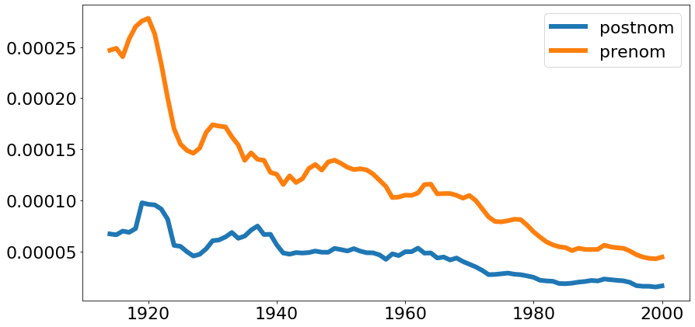
Relational nouns

Slide 17
Conclusion
The evidence suggests that the postnominal form is more and more chosen over the prenominal.

